Slide 1
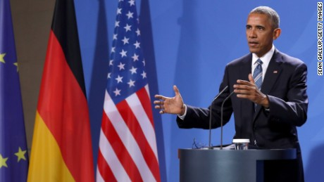
President Obama speaking November 17, 2016 in Germany:
“If we are not serious about facts and what’s true and what’s not, and particularly in an age of social media when so many people are getting their information in sound bites and off their phones, if we can’t discriminate between serious arguments and propaganda, then we have problems.”

Slide 2
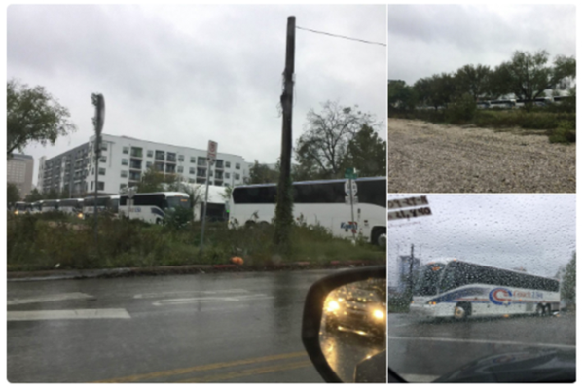
How Fake News Goes Viral: A Case Study
By Sapna Maheshwari – The New York Times
Images posted on Twitter by a marketer in Austin, Tex., the day after the presidential election.

Slide 3
How Fake News is Born
1. What trait of effective news is missing from this account?
Eric Tucker, a 35-year-old co-founder of a marketing company in Austin, Tex., had just about 40 Twitter followers. But his recent tweet about paid protesters being bused to demonstrations against President-elect Donald J. Trump fueled a nationwide conspiracy theory — one that Mr. Trump joined in promoting.
Mr. Tucker's post was shared at least 16,000 times on Twitter and more than 350,000 times on Facebook. The problem is that Mr. Tucker got it wrong. There were no such buses packed with paid protesters.
But that didn't matter.

Slide 4
The New York Times Deconstructs a Fake News Story
2. What do you anticipate will be the method the New York Times employs to deconstruct this story?
While some fake news is produced purposefully by teenagers in the Balkans or entrepreneurs in the United States seeking to make money from advertising, false information can also arise from misinformed social media posts by regular people that are seized on and spread through a hyperpartisan blogosphere.
Here, The New York Times deconstructs how Mr. Tucker’s now-deleted declaration on Twitter the night after the election turned into a fake-news phenomenon. It is an example of how, in an ever-connected world where speed often takes precedence over truth, an observation by a private citizen can quickly become a talking point, even as it is being proved false.

Slide 5
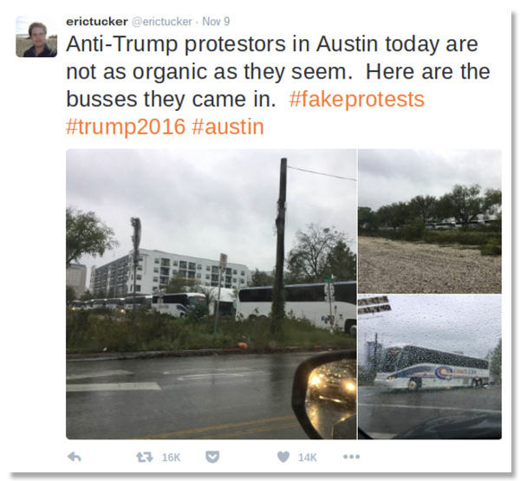
Nov. 9, shortly after 8 p.m. Eastern
3. What do you notice about the picture and text?

Slide 6
4. What is the problem with the following evidence?
Mr. Tucker, who had taken photos of a large group of buses he saw near downtown Austin earlier in the day because he thought it was unusual, saw reports of protests against Mr. Trump in the city and decided the two were connected. He posted three of the images with the declaration: “Anti-Trump protestors in Austin today are not as organic as they seem. Here are the busses they came in. #fakeprotests #trump2016 #austin”

Slide 7
5. What is the problem with the following evidence?
6. What is the reasoning error?
Mr. Tucker said he had performed a Google search to see if any conferences were being held in the area but did not find anything. (The buses were, in fact, hired by a company called Tableau Software, which was holding a conference that drew more than 13,000 people.)
“I did think in the back of my mind there could be other explanations, but it just didn’t seem plausible,” he said in an interview, noting that he had posted as a “private citizen who had a tiny Twitter following.”
He added, “I’m also a very busy businessman and I don’t have time to fact-check everything that I put out there, especially when I don’t think it’s going out there for wide consumption.”

Slide 8
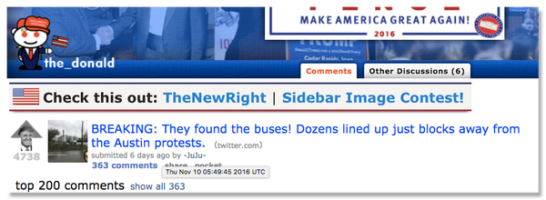
Nov. 10, 12:49 a.m. Eastern
7. What do you notice about the picture and text?

Slide 9
How Fake News Goes Viral
8. What are some of the problems with how the Tweet spread?
Several hours later, the first important step occurred. Mr. Tucker’s tweet was posted to the main Reddit community for Mr. Trump under the heading: “BREAKING: They found the buses! Dozens lined up just blocks away from the Austin protests.” It quickly generated more than 300 comments, some of which blamed the protests on George Soros, the liberal billionaire philanthropist, who is a frequent target of the group.
(According to Wikipedia, Reddit is a social news aggregation, web content rating, and discussion website. Reddit's registered community members can submit content, such as text posts or direct links.)

Slide 10
Nov. 10, around 9 a.m. Eastern
9. What are some of the problems with how the Tweet spread?
The next morning, the frenzy began. A user on Free Republic, a conservative discussion forum, linked to the Reddit thread about Mr. Tucker’s post, increasing the attention and spreading it further into the online world. Later, Facebook pages like Robertson Family Values, which is named for but not affiliated with the stars of “Duck Dynasty,” and Donald Trump Commander in Chief 2020, linked to the Free Republic discussion. Those posts were shared more than 5,000 times each, and more than 300,000 Facebook users have linked to the Free Republic thread.

Slide 11
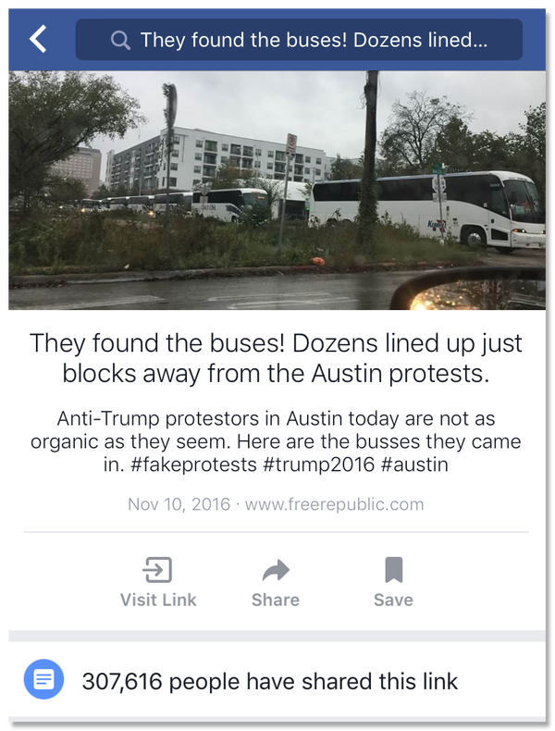
November 10, late morning through afternoon.
10. What do you notice about the picture and text?

Slide 12
11. What is the problem with the following evidence?
Sean Hughes, the director of corporate affairs for the bus company Coach USA North America, said he learned about the rumor involving its vehicles after receiving a couple of curious emails and hearing from a friend in New Jersey who had seen the claim on Facebook and wanted to know if it was true.
A reporter at the Fox television station in Austin contacted Mr. Hughes later that day, and he responded with a statement noting that “at no point were Coach USA buses involved in the Austin protests.” But that did little to stem the online furor.
“That reporter said, ‘You’re probably going to get a lot more phone calls because it’s all over the place,’” Mr. Hughes said in an interview on Thursday.
“You’re the second journalist to actually call me to see what was going on, no bloggers or anything, and we’re easily accessible on our website,” Mr. Hughes said.
He added, “I just kind of wish people looked into facts before they go ahead and do something like that, because it could be easily debunked based on a quick phone call or two, or a couple emails.”

Slide 13
Meanwhile…the reasoning errors continue.
12. What is the problem with the following evidence?
During this time, Mr. Tucker was replying to queries on Twitter about whether he had proof to support his claim. He confirmed in a post that he “did not see loading or unloading” but that the buses
were “quite near protests at right timing.” That admitted lack of evidence, however, had little effect.
By about noon, Mr. Tucker’s initial post had been retweeted and liked more than 5,000 times. There was more to come.
@stevendenoon I did not see loading or unloading. There were even more busses than in pics. Quite near protests at right timing.
— erictucker (@erictucker) November 10, 2016

Slide 14
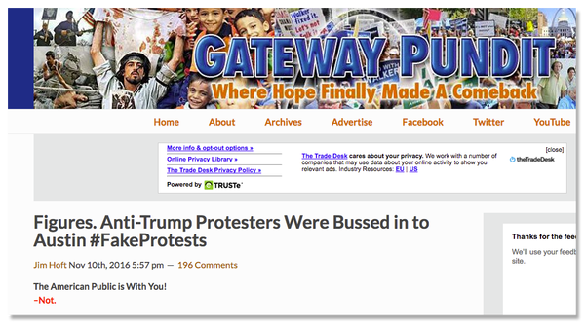
Nov. 10, evening
13. What do you notice about the picture and text?

Slide 15
14. What is the problem with the following evidence?
Around 6 p.m., the conservative blog Gateway Pundit posted a story using Mr. Tucker’s images under the headline “Figures. Anti-Trump Protesters Were Bussed in to Austin #FakeProtests.” The post, which included a mention of “Soros money,” has been shared on Facebook more than 44,000 times, according to statistics on the website.
The story line became a prominent one throughout the conservative blogosphere, with other sites incorporating Mr. Tucker’s tweet into posts about paid protesters, referring to him as an eyewitness in Austin.

Slide 16
Then, shortly after 9 p.m., Mr. Trump sent this tweet:
15. What is the problem with this Tweet?
Just had a very open and successful presidential election. Now professional protesters, incited by the media, are protesting. Very unfair!
— Donald J. Trump (@realDonaldTrump) November 11, 2016

Slide 17
16. What is the faulty reasoning in Mr. Tucker’s thinking?
Mr. Tucker considered deleting his tweet about the buses, but Mr. Trump’s message emboldened him. “I figured if he were to say something like that, I might be barking up the same tree,” Mr. Tucker said.
When asked if Mr. Trump might have been relying, at least tangentially, on the erroneous message he had sent about the buses, Mr. Tucker said, “I don’t want to say why Trump tweeted when he tweeted. I just don’t know and I truthfully don’t think any of us will ever know.”

Slide 18
November 11
17. What was the actual reason for the buses?
Doreen Jarman, a spokeswoman for Tableau, said the company issued a statement to the local television station KVUE and The Austin American-Statesman on Nov. 11, saying that the buses were connected to the company’s conference.
The American-Statesman posted an article online shortly after noon, said Asher Price, the article’s author. Around 2 p.m., Mr. Tucker tweeted a link to his blog, where he acknowledged that he could have been “flat wrong,” and mentioned that he had voted for Gary Johnson. The rumor-checking website Snopes also debunked the claim that the buses were connected to any protests. None of this seemed to have much impact.
Mr. Tucker’s initial tweet continued to generate thousands of shares on Facebook through Free Republic and pages like Right Wing News and Joe the Plumber.

Slide 19
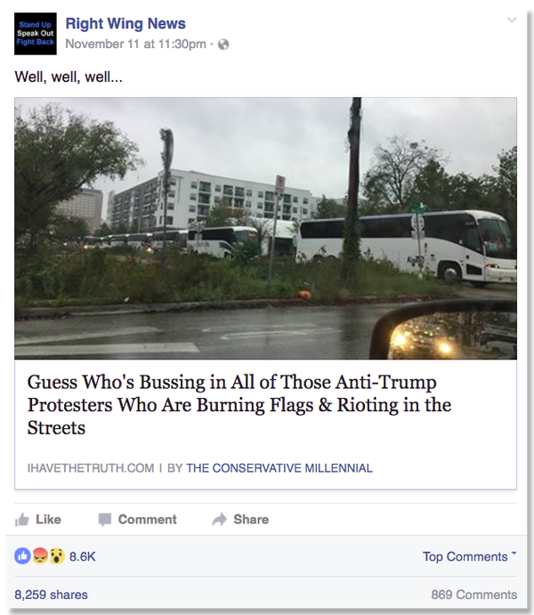
18. What do you notice about the picture and text?

Slide 20
19. Why do you think this new Tweet did not receive much attention?
After midnight, Mr. Tucker deleted his original tweet, then posted an image of it stamped with the word “false” for posterity. It did not receive much attention.
After a week, that message had 29 retweets and 27 likes. The Snopes article has been shared about 5,800 times according to its website, a fraction of the number for the fake version of the news. Faced with the impact of his initial tweet, Mr. Tucker, who now has about 960 Twitter followers, allowed himself a moment of reflection.

Slide 21
20. Why are people more prone to believe lies even after they have been debunked?
“Anytime you see me in the future going out there where I think there’s
going to be a big audience, I can assure you I’m going to try my best to be balanced with the facts and be very clear about what is opinion and what is not,” Mr. Tucker said.
If he could go back, he said, “I might have still tweeted it but very differently.
I think it goes without saying I would have tried to make a more objective statement.”
And BOOM! The old big bad post is gone! Its memory shall live on!
Thanks all! Let's keep the conversation moving! https://t.co/DHz37Le9i8 pic.twitter.com/YME1TN4q4D
— erictucker (@erictucker) November 12, 2016

Slide 22
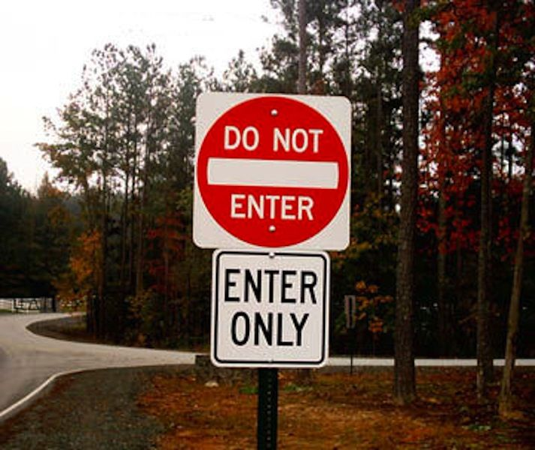
“Why we Believe Lies Even When we Know the Truth”
For an explanation of this behavior, look no further than the psychological theory of cognitive dissonance.
cognition – process of acquiring knowledge and understanding through experience and thought.
dissonance – a clash between beliefs one holds or between one’s actions and beliefs.

Slide 23
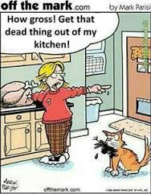
Cognitive Dissonance
This theory holds that when people are presented with information that contradicts preexisting beliefs, they try to relieve the cognitive tension one way or another.

Slide 24
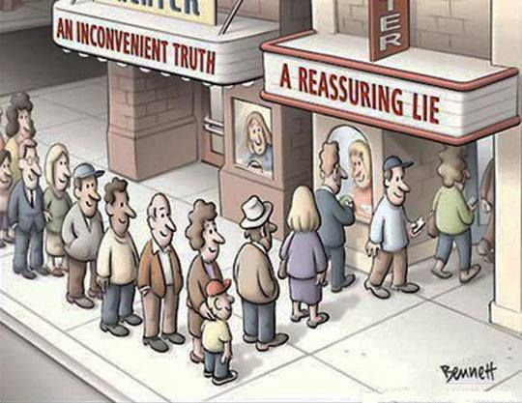
Cognitive Dissonance
They process and respond to information defensively, for instance: their belief challenged by fact, they ignore the latter..

Slide 25

Cognitive Dissonance
They also accept and seek out confirming information but ignore, discredit the source of, or argue against contrary information, studies have shown. Sharon Begley, Newsweek, Aug. 29, 2009

Slide 26
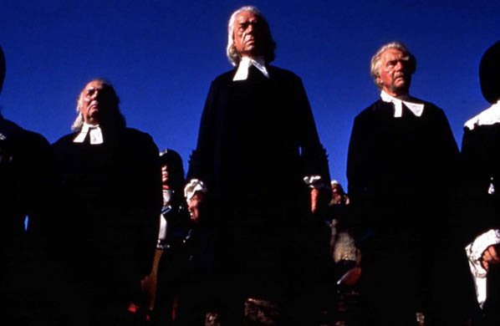
Cognitive Dissonance in The Crucible
In Arthur Miller’s The Crucible, the judges and ministers engage in cognitive dissonance when they ignore and discredit those who provide evidence contrary to their belief. As a result, innocent people are jailed, and some are sentenced to death, due to the judges and ministers wishing to protect their own reputations.

Slide 27
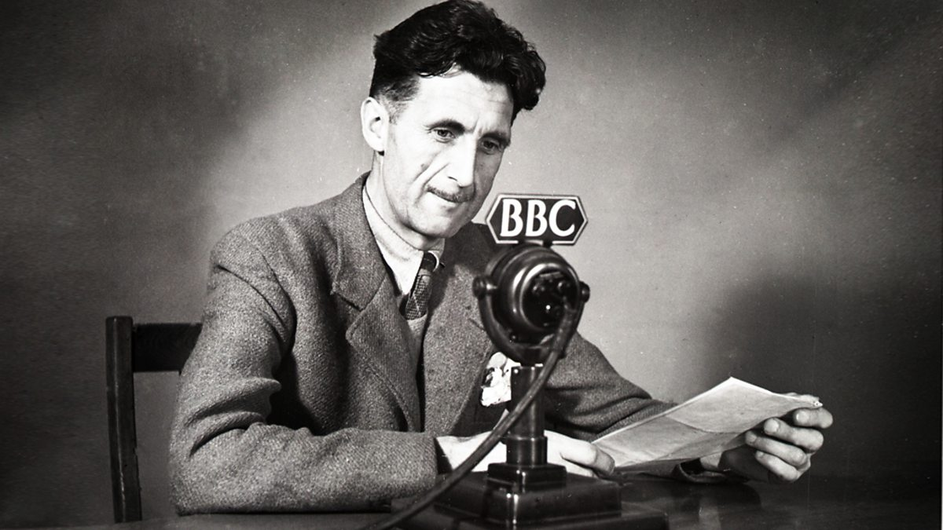
“In a time of deceit, truth is a revolutionary act.” George Orwell

Slide 28
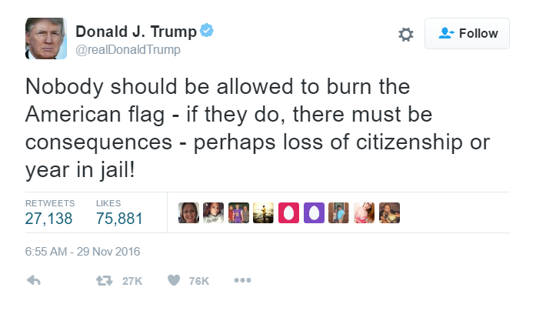
The next series of articles discuss this Tweet:

